Slide 1
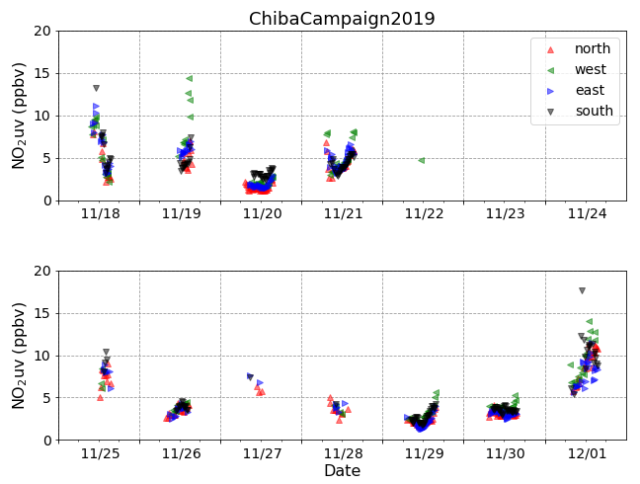
NO₂ time series

Slide 2
NO₂ time series
hour

Slide 3
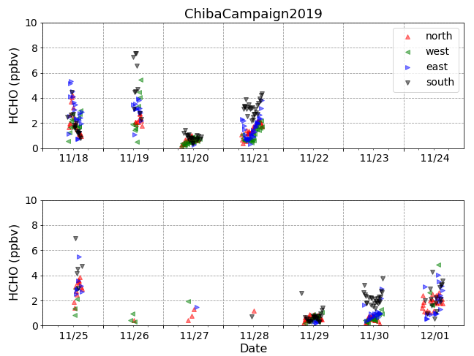
HCHO time series

Slide 4
HCHO time series
hour

